Slide 1
Using Big Data to Study Post-traumatic Epilepsy
By Galilea Patricio

Slide 2
Epilepsy Bioinformatics Study for Antiepileptogenic Therapy (EpiBioS4Rx)
EpiBioS4Rx strives to:
Develop clinical techniques
Create large-scale patient populations
Facilitate development of AEG therapies
Remove barriers to collaborative research
University of Southern California, Mark and Mary Stevens Neuroimaging and Informatics Institute. (n.d.). EpiBioS4Rx. Retrieved from http://epibios.loni.usc.edu/.
Notes:
EpiBioS4Rx is an international, multicenter, and multidisciplinary effort that focuses on the prevention of epileptogenesis following Traumatic Brain Injury or TBI.
EpiBioS4Rx strives to:
Develop clinical techniques and large-scale patient populations in an effort to create an extensive and rigorous standardized preclinical trial protocol
this is in order to allow for compounds with antiepileptogenic potential to transition from the preclinical to clinical trials, which currently is minimal due to the lack of reproducibility among laboratories that would justify testing these potential compounds.
The study also strives to facilitate the development of antiepileptogenic therapies by encouraging and removing barriers for international collaborative research of multidisciplinary teams of basic and clinical scientists.
All of these endeavors are in efforts to develop a cost effective and full-scale clinical trials for epilepsy prevention techniques.
On the next slide I will briefly explain the approaches taken by the study.

Slide 3
Epilepsy Bioinformatics Study for Antiepileptogenic Therapy (EpiBioS4Rx)
1.
Identify biomarkers of epileptogenesis
2.
Standardize AEG therapies and identify AEG agents
3.
Create open shared resources
Notes:
The first approach is the identification of biomarkers of epileptogenesis in human and animal models
This is done through neuroimaging, blood samples, and conducting electrophysiological tests such as EEGs → all of these are measured at different post-injury time points.
The second approach is to create a standardized preclinical protocol for potential antiepileptogenic therapies, as mentioned in the previous slide, as well as identify one or more antiepileptogenic agents.
The third approach is to create open shared resources with the epilepsy community by having an open access bioinformatics platform and making the “big data” generated through the study openly available.

Slide 4
Big Data Challenges
Big Data
Dataset contained over 12 million data points per electrode contact (15 total).
Coding
Becoming acquainted with MATLAB
Trial & Error
Technical and analytical challenges making visualization of data difficult.
Notes:
I will now talk about the big data challenges I experienced, as mentioned before → the study generates ”big data” and the data set that I worked with was pretty big.
The dataset contained a total of 15 electrode contact points, each with over 12 million data points.
Another challenge was becoming acquainted with MATLAB
I recently started coding for the first time through R studio this past Spring semester which was a struggle in itself, but overall a matter of practice.
Although the minimal experience I had from R helped me pick up MATLAB, it was still challenging learning a completely new software and starting over.
Particularly when it came to learning commands and functions specific for signal processing and spectral analysis
Lastly, another challenge I faced was basic trial & error
Due to the volume of the dataset, with each electrode contact point have over 12 million data points, there were technical and analytical issues
For example when it came to analyzing multiple contact points → my laptop and MATLAB were put up to the test
MATLAB would either become too busy or crash and loose a majority of my work and settings, all of which had to be reapplied numerous times.
Another example was the coding → it’s a matter of practice and testing out different functions.
I was constantly adjusting the syntax for commands in order for them to work and also for the values to create the spectrograms that I will demonstrate up next.

Slide 5
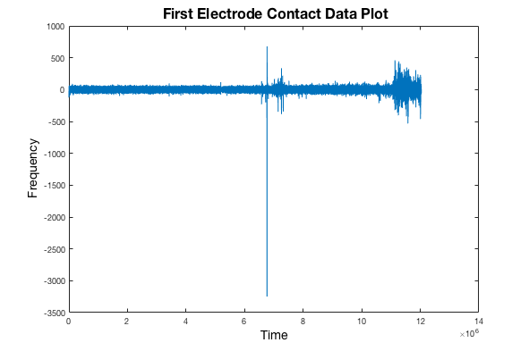
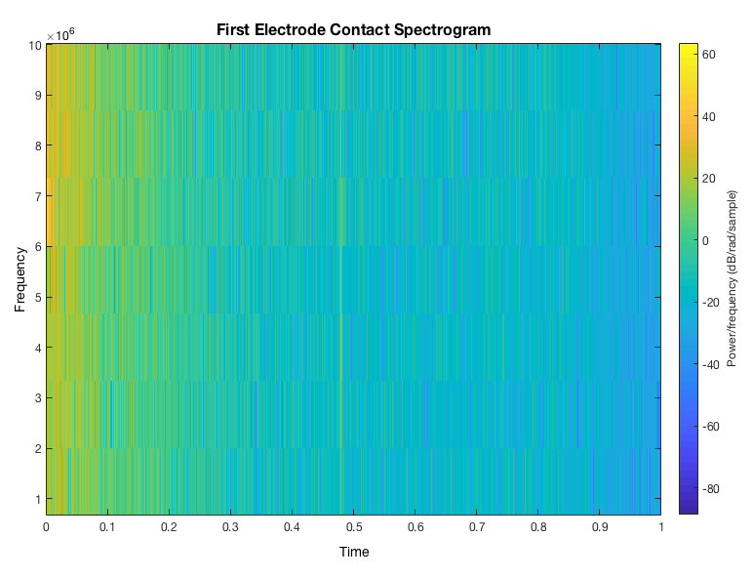
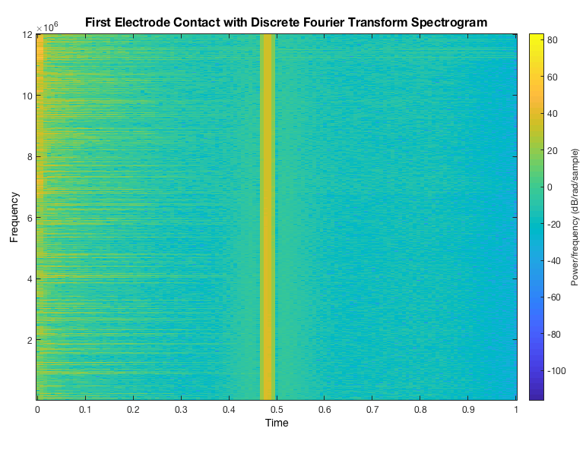
Visualization of EEG Data
Progress of EEG data visualization of activity from the first electrode contact
Notes:
Notes: make sure to further explain: yellow marks on the left can be indicative of oncoming seizure activity, yellow line in the middle could potentially be an artifact though concrete information or explanation is inconclusive → further analysis is required, label axis on plot graphs, these are the initial steps in analyzing this data.
These images are the progression of EEG data visualization of activity from the first electrode contact
The first image is a ”raw” plot of the data done as a means to see the activity for that electrode contact point
Next, I created a spectrogram, which is a visual representation of the spectrum of frequencies, such as sound and other signals, as they vary with time or some other variable.
This first spectrogram is an initial visual before adjusting and calculating for the discrete Fourier transform (which I will explain on the following slide).
Finally, this second spectrogram depicts the data after being adjusted.
As you can see there are these yellow spikes to the left of the image which can be indicate of oncoming seizure activity and the line in the middle could potentially be an artifact though a concrete explanation is inconclusive → and further analysis is required.

Slide 6
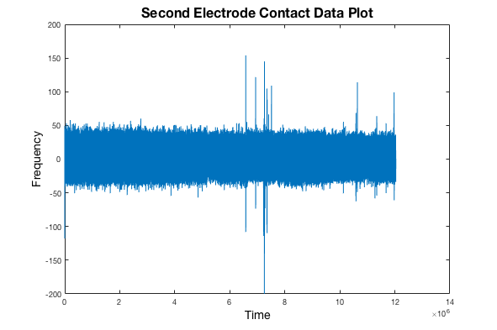
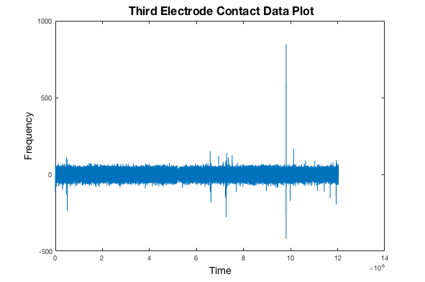
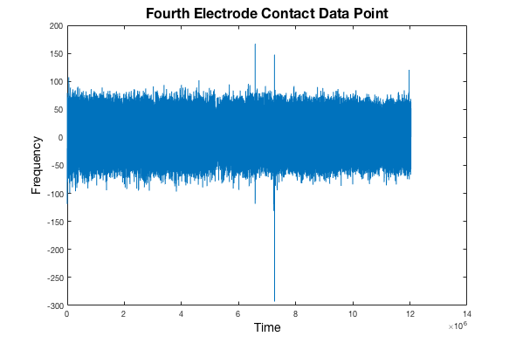
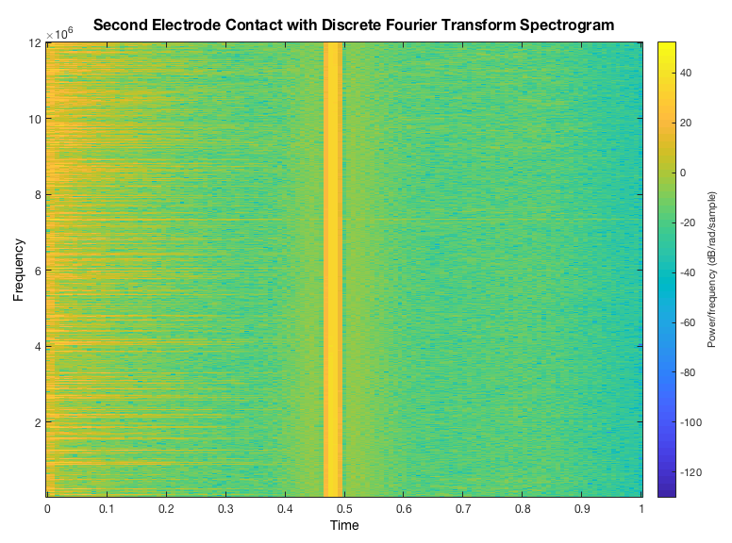
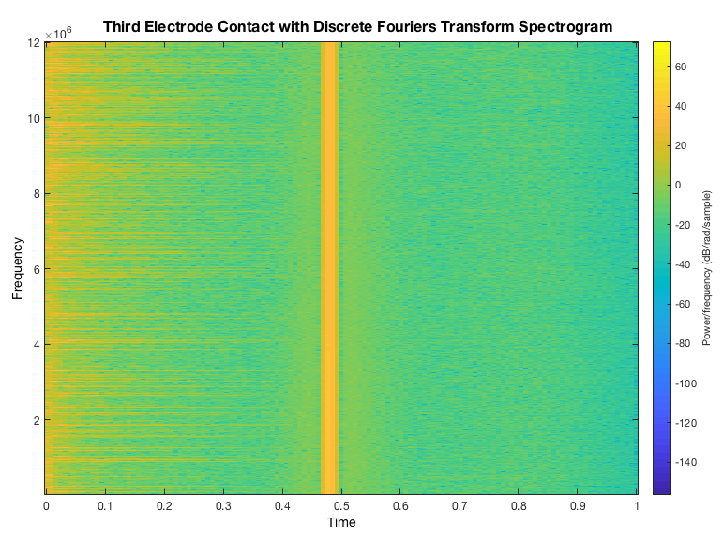
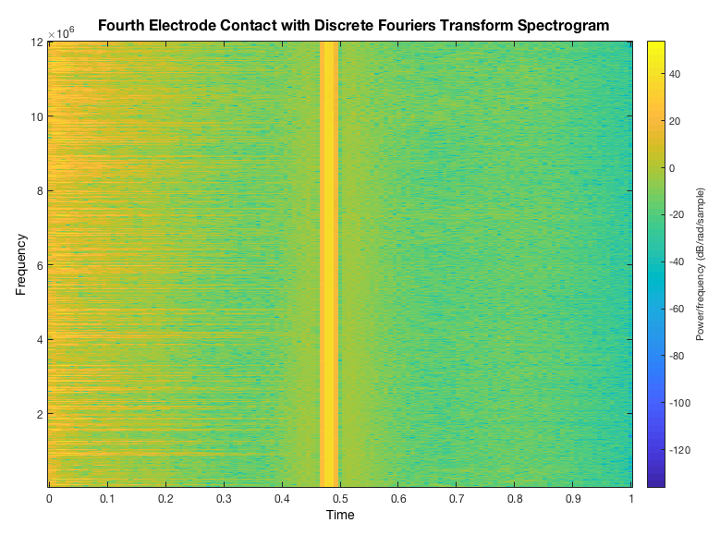
Visualization of EEG Data
Notes:
Notes: Label axis for plots, explain comparison of initial raw data with final spectrogram created → as a visual reference of continuing electrode contact points
I included these images to demonstrate the variation between the second, third, and fourth electrode contact points.
Even though the amounts varies, you can still see these persisting yellow spikes and line throughout.

Slide 7
Calculating Spectrograms
Spectrogram(x,window,noverlap,nfft)
X → x = test(1,:);
window → w = hamming(L);
noverlap → noverlap = [L/2];
nfft → p = log2(L)
Max(256,2^p)
Spectrogram(x,250,100,250)
Notes:
Notes: Not everyone will know what the values are so explain them
The command used to create the final spectrogram is the function listed above
For ”x” → it was assigned based on the desired electrode contact point
”window” → is used to divide the signal into segments
In this case I used the “hamming” window calculation, which calculates a symmetric window using the length of “x”
“noverlap” → is the number of overlapped samples
For scalar and vector windows, noverlap must be smaller, I chose to have a 50% overlap between segments
Finally ”nfft” → is the number of discrete Fourier transform or DFT points
Discrete Fourier transform is used in digital signal processing of any signal that varies over time and reveals the relative strength of intervals, MATLAB calculates this to create equally spaced frequencies
The following commands are used when nfft is unspecified
All of the input arguments used to form the final spectrogram command were obtained from the MATLAB documentation.
I also found different input arguments posted on forums, however, many of these resulted in error messages
There was also the option of simply inputting integer values

Slide 8
Conclusion
Further analysis and testing is required.
Great learning opportunity!
Experience with new software
Significance of big data in this study
Further experience in research
Notes:
Although I mentioned some of the spectrograms in this presentation as “final” → there is still much testing and analysis to be performed as the images inconclusive and may or may not be indicative of something significant.
Overall, this summer experience was a great learning opportunity
I can now say I have worked with and know how to use MATLAB and therefore my use of technology has expanded
I also learned the significance of big data in this study… big data in itself is significant but in learning and reading about epilepsy and this study, the possibilities for epilepsy prevention and modification can help change millions of lives.
Finally, I gained further experience in what goes into conducting research, specifically data analysis, which I can apply during upcoming school year in the BD3-REAP program

Slide 9
Acknowledgments
Dr. Dominique Duncan
Dr. Jack Van Horn
BD2K and BD3-REAP programs

